Slide 1
ADVERSARIAL ATTACK AGAINST NEURAL NETWORKS
Rohan Pradhan | Nirmal Kanagasabai

Slide 2
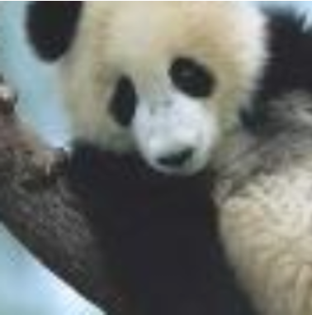
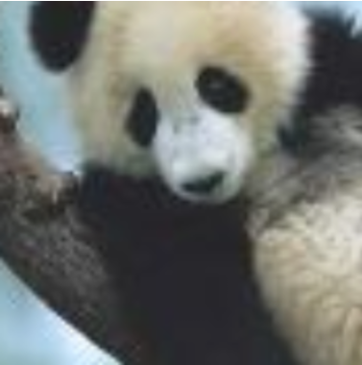
QUICK TEST ON IMAGE CLASSIFICATION
What are the differences between these two images?
What would you classify both these images as?
How confident are you in your classification?

Slide 3
RESULT
PANDA Confidence: 57.7%
GIBBON Confidence: 99.3%

Slide 4
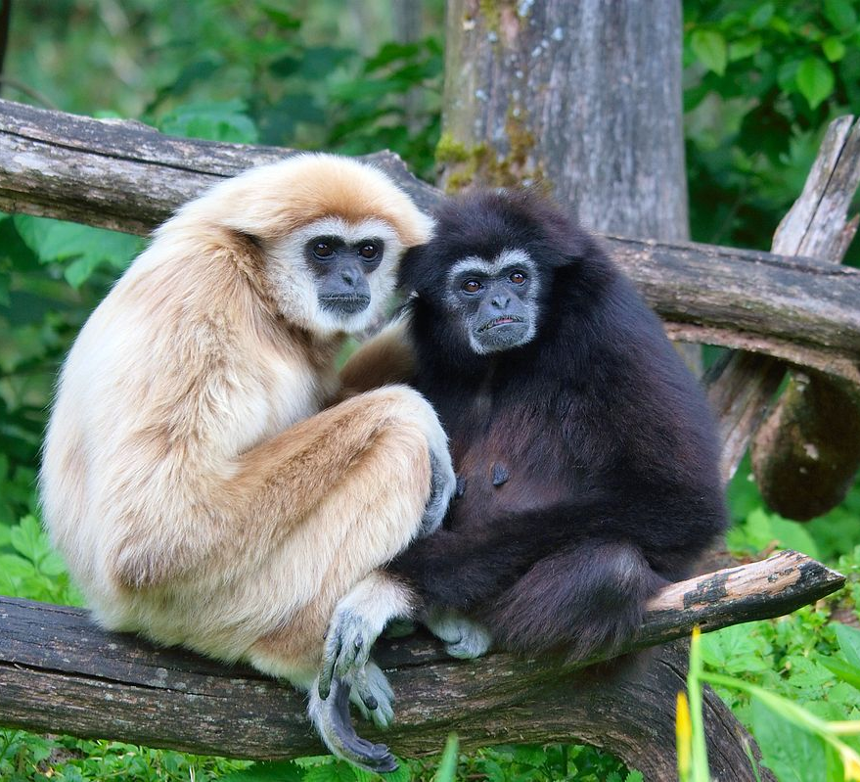
HOW AN ACTUAL GIBBON LOOKS LIKE…

Slide 5
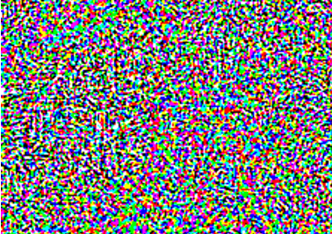
SO, WHAT WENT WRONG?
Input Data
Perturbation (Minor Modification)
Adversarial Example

Slide 6
ADVERSARIAL EXAMPLE
Input Data
Minor Modification
Adversarial Example
Intended to cause Machine Learning to misclassify it
The differences cannot be seen by the naked eye
The minor modification (perturbation) only affect 32-bit floating point values while the display resolution is only showing 8-bit floating point

Slide 7
DOMAIN EXAMPLES OF ADVERSARIAL ATTACK
Computer Vision Attacks:
Gradient Ascent Attack
Fast Sign Gradient Descent
Spam Filter / Spam Bayes:
Causative vs. Exploratory Attacks
Integrity vs. Availability Attacks
Targeted vs. Indiscriminate Attacks

Slide 8
EXISTING WORK AND RESEARCH
Defending against Adversarial attack is difficult
Carried out on training models with adversarial examples to prevent the effect from adversarial attack
- Limited success with this approach
Some promising results against attacks using Fast Gradient Sign Method
- Lack of results in attacks using Ensemble methods
Reject On Negative Impact (RONI) Defense
- Used in Spam Filtering

Slide 9


OUR PROPOSED EXTENSIONS
Recreate a simple attacker using the Fast Gradient Sign Method for known models
Recreate a Transfer Learning model using Transfer Learning techniques to create an attacker that can successfully attack deep learning models that we do not have prior knowledge to
Dataset: MNIST Image set

Slide 10
OUR PROPOSED TIMELINE
Create a simple image classifier using Deep Neural Networks
Test on Control set with random noise perturbations added
- Not for Fast Gradient Sign Method
- Ensure that it still performs well
Use Fast Gradient Sign Method to create targeted adversarial attacks on known models
Use transfer learning to infer Input to Output mapping to create targeted adversarial attacks on unknown (3rd party) models

Slide 11
WHAT’S DONE?
Create a simple image classifier using Deep Neural Networks
Test on Control set with random noise perturbations added
- Not for Fast Gradient Sign Method
- Ensure that it still performs well
Use Fast Gradient Sign Method to create targeted adversarial attacks on known models
Use transfer learning to infer Input to Output mapping to create targeted adversarial attacks on unknown (3rd party) models

Slide 12
PHASE 1
Digit Recognition (Multi-Class Image Classification) for the MNIST Dataset
Logistic Regression
Random Forest
K-Nearest Neighbours
Convolutional Deep Neural Network Classifier
Notes:
2 layers of convolution
A dropout layer of 25 percent
Dense layer using a relu activation function
Another dropout layer of 50 percent
Then a dense layer using a softmax activation function
Logistic Regression (Linear & Parametric) -> Representations are fixed (They do not grow)
Random Forest & KNN (Parametric) – Trees Grow. So does KNN
Easy to train. Longer to predict
Model Fitting & Training Phase (present)
KNN – Lazy Learner (Just memorizes the training data set) – Does not learn a deterministic function

Slide 13
ADDITION OF NOISE
As the original train and test images were loaded as Numpy arrays, a noise signal was introduced into them through Random sampling by numpy.random.normal (Normal “Gaussian” Distribution). The parameters include:
Mean “Centre” of the distribution
Standard Deviation “Spread or “Width” of the distribution
Size (of the dataset)

Slide 14
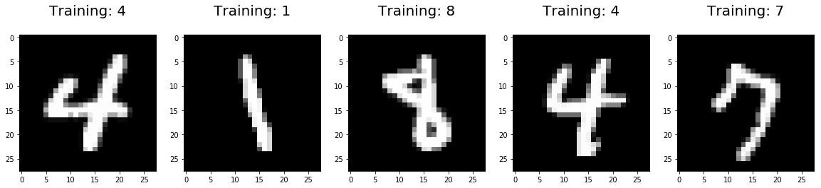
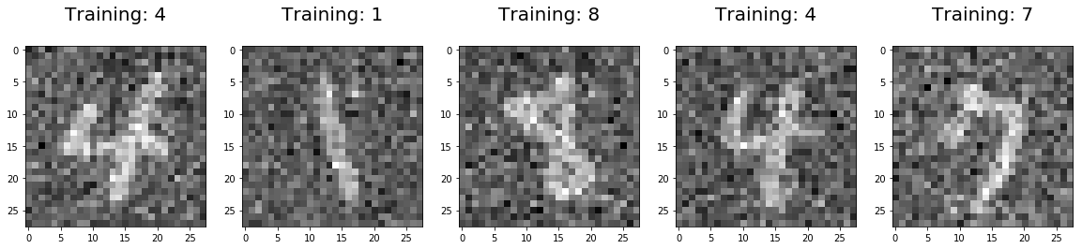
ADDITION OF NOISE
Original Image
Perturbed Image

Slide 15
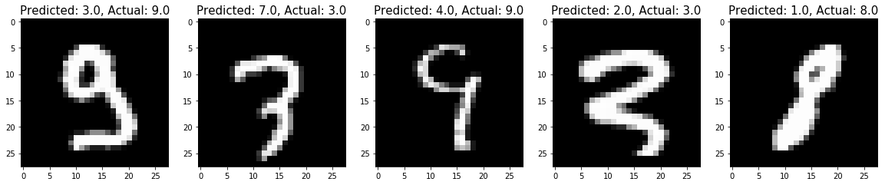
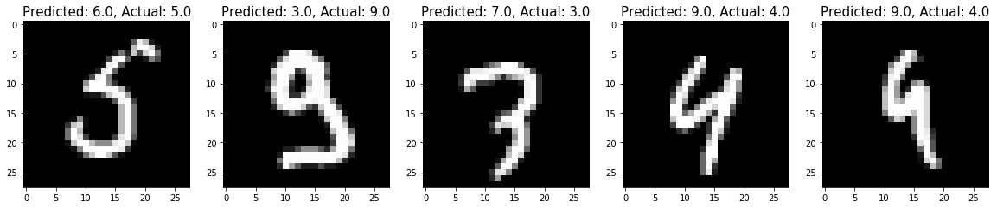
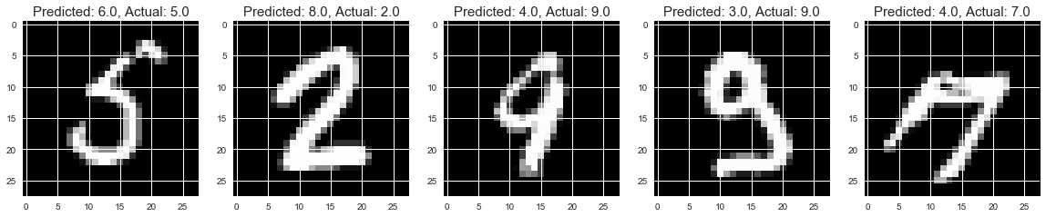
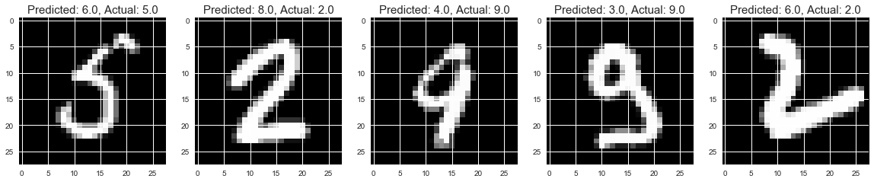
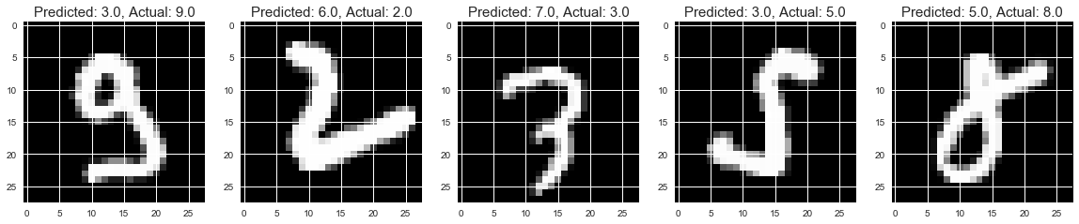
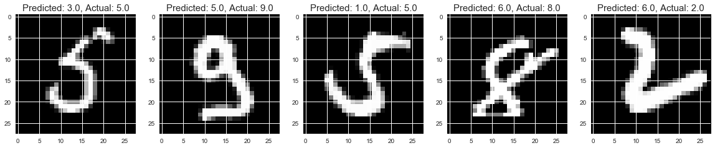
MISCLASSIFIED IMAGES
K - Nearest
Neighbours
Logistic
Regression
Random
Forest

Slide 16
ADDITION OF NOISE
Classifier | Test Type | Test Accuracy
Logistic Regression | Without Noise | 91.30%
 | With Noise | 86.78%
Random Forest | Without Noise | 94.62%
 | With Noise | 80.80%
K-Nearest Neighbors | Without Noise | 97.18%
 | With Noise | 97.01%
Deep Neural Network | Without Noise | 99.04%
 | With Noise | 99.02%
Notes:
Logisitc Regression (Discriminative Algorithm)

Slide 17
PURE SIGNAL (WITHOUT NOISE)

Slide 18
ADDITION OF RANDOM (CALCULATED) NOISE SIGNAL

Slide 19
MAXIMIZING L2 NORM IN A SPECIFIC AREA
Maximizing L2 Norm in specific area

Slide 20
MAXIMIZING L2 NORM WITHOUT FOCUSING IT ON A SPECIFIC AREA

Slide 21
WHAT NEXT?
Create a simple image classifier using Deep Neural Networks
Test on Control set with random noise perturbations added
- Not for Fast Gradient Sign Method
- Ensure that it still performs well
Use Fast Gradient Sign Method to create untargeted adversarial attacks on known models
Use transfer learning to infer Input to Output mapping to create targeted adversarial attacks on unknown (3rd party) models

Slide 22
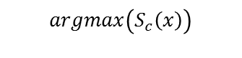
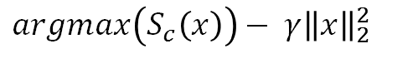
Fast-Gradient Sign Method
$$argmax\left(S_{c}\left(x\right)\right)$$
Some classification of an image x
Need to add noise dependent on the image
Add a regularization term?
$argmax\left(S_{c}\left(x\right)\right)− {γ\left\|x\right\|}_{2}^{2}$
Some classification of an image x with a regularization L2 term using image x
Notes:
Explaining and Harnessing Adversarial Examples - https://arxiv.org/abs/1412.6572

Slide 23
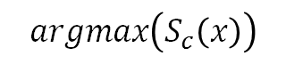
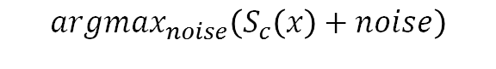
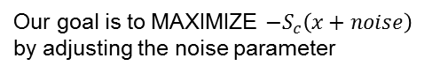
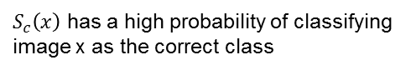
Fast-Gradient Sign Method
$$argmax\left(S_{c}\left(x\right)\right)$$
$S_{c}\left(x\right)$ has a high probability of classifying image x as the correct class
Our goal is to MAXIMIZE $−S_{c}\left(x+noise\right)$ by adjusting the noise parameter
$${argmax}_{noise}\left(S_{c}\left(x\right)+noise\right)$$
Simple?
Notes:
Explaining and Harnessing Adversarial Examples - https://arxiv.org/abs/1412.6572

Slide 24
Fast-Gradient Sign Method
$$argmax\left(S_{c}\left(x\right)\right)$$
$S_{c}\left(x\right)$ has a high probability of classifying image x as the correct class
Our goal is to MAXIMIZE $−S_{c}\left(x+noise\right)$ by adjusting the noise parameter
$${argmax}_{noise}\left(S_{c}\left(x\right)+noise\right)$$
Simple?
NOT SO FAST!
Notes:
Explaining and Harnessing Adversarial Examples - https://arxiv.org/abs/1412.6572

Slide 25
Fast-Gradient Sign Method
Maximizing L2 Norm in specific area
Remember this?
Notes:
Explaining and Harnessing Adversarial Examples - https://arxiv.org/abs/1412.6572

Slide 26
Fast-Gradient Sign Method
We can’t just maximize the noise parameter or else we will distort the original image
Notes:
Explaining and Harnessing Adversarial Examples - https://arxiv.org/abs/1412.6572

Slide 27
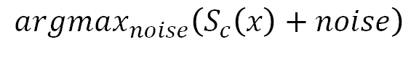

Fast-Gradient Sign Method
$${argmax}_{noise}\left(S_{c}\left(x\right)+noise\right)$$
We must also penalize the L2 norm of the noise
$$\hat{x}=x+noise w.r.t minimized L2 norm$$
$\hat{x}$ is the adversarial image
Notes:
Explaining and Harnessing Adversarial Examples - https://arxiv.org/abs/1412.6572

Slide 28
Fast-Gradient Sign Method
$$X^{adverserial}=X+ε(sign\left(∇_{x}J\left(X,y_{true}\right)\right))$$
Notes:
Explaining and Harnessing Adversarial Examples - https://arxiv.org/abs/1412.6572

Slide 29
Fast-Gradient Sign Method
$$X^{adverserial}=X+ε(sign\left(∇_{x}J\left(X,y_{true}\right)\right))$$
Actual score of classification y on input X
Notes:
Explaining and Harnessing Adversarial Examples - https://arxiv.org/abs/1412.6572

Slide 30
DEMO - ADVERSARIAL EXAMPLE
Goal:
Implement a simplistic ‘Fast Gradient Sign Method’ ^{[1]}
Used to modify classical samples that a DNN trained classification will fail to classify properly
Notes:
Explaining and Harnessing Adversarial Examples - https://arxiv.org/abs/1412.6572

Slide 31
DEMO - ADVERSARIAL EXAMPLE
Idea:
Take a sample
Ask the network to classify it
Compute the gradient of the loss in function of the input pixels
Update the picture by a small amount (Perturbation) in the direction of the gradient
Note: Direction is opposite to the one that would increase the score for the correct class
Notes:
Explaining and Harnessing Adversarial Examples - https://arxiv.org/abs/1412.6572

Slide 32
CLEVERHANS
Open-Source Python library
Used to help create adversarial attacks
Used to benchmark Machine Learning systems’ vulnerability to Adversarial examples
Developed by Nicolas Papernot (Pennsylvania State University), Ian GoodFellow (Google Brain) & co.
Adversarial Training:
Brute force solution where a lot of adversarial examples are generated
Explicitly training the model not to be fooled by each of them
Notes:
Explaining and Harnessing Adversarial Examples - https://arxiv.org/abs/1412.6572

Slide 33
CLEVERHANS
Classifier | Test Type | Accuracy
Epoch 0 | Legitimate Examples | 0.9881
Epoch 1 | Legitimate Examples | 0.9894
Epoch 2 | Legitimate Examples | 0.9915
Epoch 3 | Legitimate Examples | 0.9911
Epoch 4 | Legitimate Examples | 0.9931
Epoch 5 | Legitimate Examples | 0.9925
Test accuracy on adversarial examples: 0.0700
Notes:
Explaining and Harnessing Adversarial Examples - https://arxiv.org/abs/1412.6572

Slide 34
CLEVERHANS
Classifier | Test Type | Accuracy
Epoch 0 | Legitimate Examples | 0.9792
 | Adversarial Examples | 0.8355
Epoch 1 | Legitimate Examples | 0.9883
 | Adversarial Examples | 0.9118
Epoch 2 | Legitimate Examples | 0.9854
 | Adversarial Examples | 0.9099
Epoch 3 | Legitimate Examples | 0.9915
 | Adversarial Examples | 0.9459
Epoch 4 | Legitimate Examples | 0.9914
 | Adversarial Examples | 0.9458
Epoch 5 | Legitimate Examples | 0.9927
 | Adversarial Examples | 0.9625
Notes:
Explaining and Harnessing Adversarial Examples - https://arxiv.org/abs/1412.6572

Slide 35
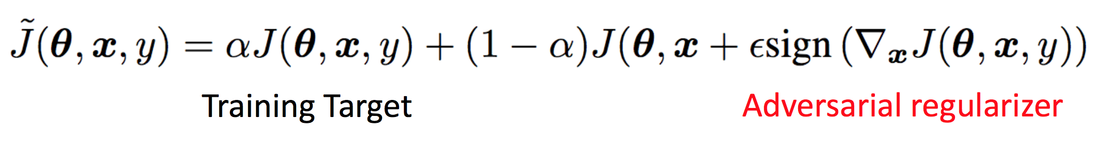
Adversarial Regularization?
Training with adversarial examples and legitimate examples can be beneficial
By training on adversarial and legitimate examples network can be made more robust

Slide 36
WHAT NEXT?
Create a simple image classifier using Deep Neural Networks
Test on Control set with random noise perturbations added
Use Fast Gradient Sign Method to create untargeted adversarial attacks on known models
Use Black-box attack where adversary trains its own substitute model. Use the substitute model to pick adversarial examples on legitimate model
Use transfer learning to infer Input to Output mapping to create targeted adversarial attacks on unknown (3rd party) models

